Slide 1
Providing Multilingual Health Information
Sarah Levin-Lederer, MPH
Education and Outreach Coordinator, Region 7
Notes:
Hi everyone!
Welcome to Providing Multilingual Health Information.. Thank you so much for joining this webinar and taking time to learn about Health information resources available for those who speak a language other than English.

Slide 2
NNLM
Trainings
Funding
Educational materials
Community outreach
Notes:
Before we get started, I want to introduce the Network of the National Library of Medicine, also known as NNLM. As the name suggests, the NNLM is part of the National Library of Medicine, which is within the National Institutes of Health. We are the education and outreach arm of the National Library of Medicine. We work regionally, getting to know communities and helping those communities serve the people they know best.
We are also present across the entire country, and we work to advance the health and well being of everyone through access and understanding of how to use health information. This includes both working with organizations like libraries of all types, schools, health care, and all sorts of community-based organizations.
We do this primarily through three different methods: 1) providing funding to organizations so that they can work within their own communities; 2) other forms of outreach and engagement; And then like today, we offer a wide range of training and education opportunities.
I represent Region 3, here in the center, which includes the states of Arkansas, Kansas, Louisiana, Missouri, Nebraska, Oklahoma, and Texas.
You might also be interested in one of our new offerings. We recently launched the NNLM Discovery podcast. Podcasts are available wherever you get your podcasts or on nnlm.gov/podcast
I encourage you all to visit nnlm.gov to learn more.
Connect With Your Region 3: https://library.unthsc.edu/nnlmregion3/

Slide 3
Agenda
Explore immigration and language usage data at the national and state level.
Identify reliable websites for quality health information in multiple languages.
Live demonstration of websites.
Notes:
Here are our is our agenda for the next hour.
I think that if you chose to attend this webinar, then you’re probably already in agreement that We all need health and medical information in language that we can understand.
To that end, We will start with some brief background information and describe statistics related to immigrants in the United States; we’ll review some websites to show you how to access data when planning for the language needs in your community;
The I will give you a tour of a few websites that offer free, reliable health information in multiple languages.

Slide 4
Question: Languages in Your Community
What are the most common languages you run into in your community or at your library?
Notes:
To get started What are the most common languages other than English you run into in your community or at your library? Please add your answers in the chat and if you are unsure then that is good too!
My experience in working with information in multiple languages is primarily the need for Spanish as there are a lot of people who speak Spanish in my community. So, If I am looking for documents to share, I want to make sure there is also a version in Spanish. But I have also had requests for Pashto, and Arabic.
I am seeing----------------Thank you for sharing. The reason I asked is to help us see there are more and more people in the US seeking information in languages other than English and health information is no exception.

Slide 5
Background Data
Notes:
The first section that we’ll cover gives some general statistics about immigrants and language usage in the United States.

Slide 6
2023 Data on Immigrants
48 Million Immigrants
14.4 % of U.S. Population
Source: https://data.census.gov/table/ACSSPP1Y2023.S0201?t=601:Foreign-Born&y=2023
Notes:
Source:
https://data.census.gov/table/ACSSPP1Y2023.S0201?t=601:Foreign-Born&y=2023
When you see or hear the word immigrant, or foreign-born many definitions may come to mind. According to the U.S. census bureau, the term "foreign born" refers to people residing in the United States who were not U.S. citizens at birth. This population includes naturalized citizens, lawful permanent residents, certain legal nonimmigrants such as persons on student or work visas who are temporary migrants, those admitted under refugee or asylee status who are humanitarian migrants, and unauthorized migrants residing in the United States.
I do want to point out that this is not “new arrival” data but those included as foreign born may have lived in the United States for 75 years and been naturalized citizens for much of their lives.
According to US Census data for 2023, there are about 48 million immigrants in the United States which represents 14.4% of the overall population. To put this into context of January 1, 2024, U.S. Census Bureau projected the U.S. population to be around 335.9 million.
Additional sources of information:
2018-2022 numbers from the Migration Policy Institute
https://www.migrationpolicy.org/programs/data-hub/charts/us-immigrant-population-state-and-county
Https://www.census.gov/topics/population/foreign-born/about.html#par_textimage
Total Households in U.S. Census Bureau Table
https://data.census.gov/table/ACSDP1Y2022.DP02?g=010XX00US
United States - Census Bureau Profile Infographics https://data.census.gov/profile/United_States?g=010XX00US

Slide 7
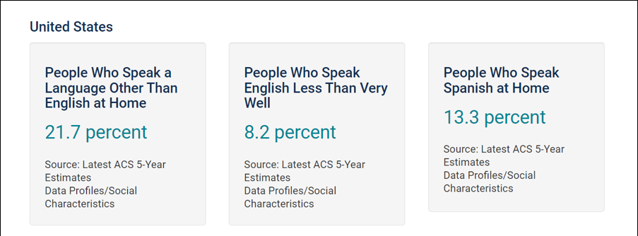
Language in the United States
https://www.census.gov/acs/www/about/why-we-ask-each-question/language/
Notes:
The graphic on the slide is a screenshot from a Census tool using data from 2015, but this is still fairly consistent with data from 2022.
Almost 22 percent of people in the United States speak a language other than English at home, and 8 percent have limited English proficiency (LEP). For the Census data this means people who speak English less than very well.
This tool is included in the handout and from this page, you can also search for the same data by state and county for your area using the 2015 data.
Sources:
2015 Data - People That Speak English Less Than "Very Well" in theUnitedStates (census.gov)
https://www.census.gov/acs/www/about/why-we-ask-each-question/language/
DP02: Selected Social ... - Census Bureau Table https://data.census.gov/table/ACSDP1Y2022.DP02?g=010XX00US

Slide 8
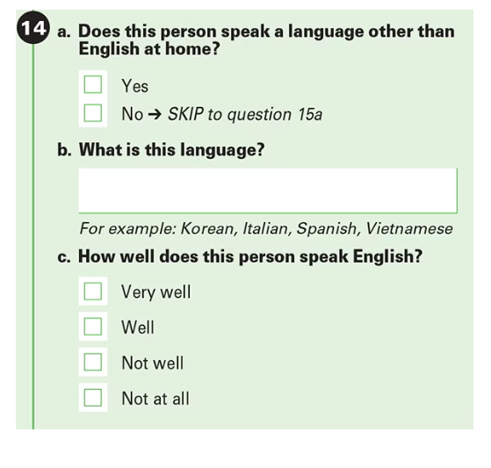
Census Question
Notes:
Where does this data come from? On the census, the following question is asked about if the person speaks a language other than English at home, if so, the language, and a self-report question asking how well does this person speak English, with the following choices, very well, well, not well and not at all. When it is reported, all the choices except very well are reported as “Less than very well”
Source:
Language Use in the United States: 2019 (census.gov) https://www.census.gov/content/dam/Census/library/publications/2022/acs/acs-50.pdf

Slide 9
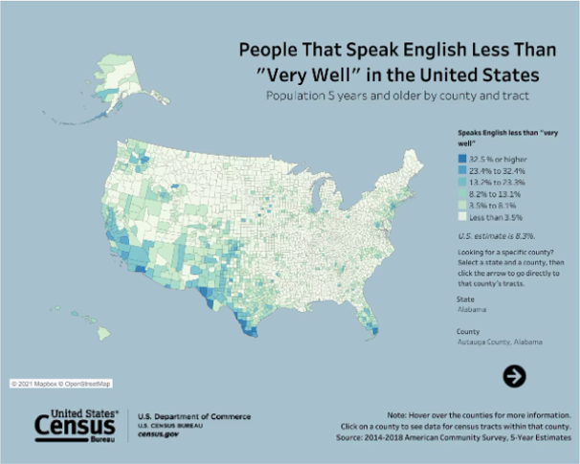
English Proficiency Levels
Source: www.census.gov/library/visualizations/interactive/people-that-speak-english-less-than-very-well.html
Notes:
I just wanted to quickly point out this tool for future reference and the link is on the class handout. The US Census Bureau has created an interactive map which shows percentages of people who indicated that they speak English less than very well on the US Census. This is displayed by color coding. You can also hover over areas and the data is displayed at the county level.
Source:
Interactive Tool People That Speak English Less Than "Very Well" in the United States (census.gov)

Slide 10
Top Languages spoken at home in the United States (2021)
Spanish……………….41.3 million
Chinese……………….3.4 million
Filipino/Tagalog…..1.72 million
Vietnamese………….1.52 million
French…………………1.18 million
Arabic…………………..1.39 million
Korean………………….1 million
Source: U.S. Census Bureau
Notes:
This is a list of the primary languages spoken other than English by people over 5 years old at home in the United States. Of the 21.7% of people over 5 years old who speak a language other than English at home, the majority speak Spanish. The next most spoken languages are Chinese, Tagalog, Vietnamese, French, Arabic and Korean.
Obviously, there is no better way to know your community than being engaged and involved with community members and partner organizations, but there are lots of good reasons to look at data as well. This can help you explain why you need resources in languages other than English and provide some insight into communities that you may be missing. But where do you go to find out about the people in your community?
Sources:
ACS B16001". ACS B16001. U.S. Census Bureau.
Most Americans Speak Only English at Home or Speak English “Very Well” (census.gov) https://www.census.gov/newsroom/press-releases/2023/language-at-home-acs-5-year.html

Slide 11
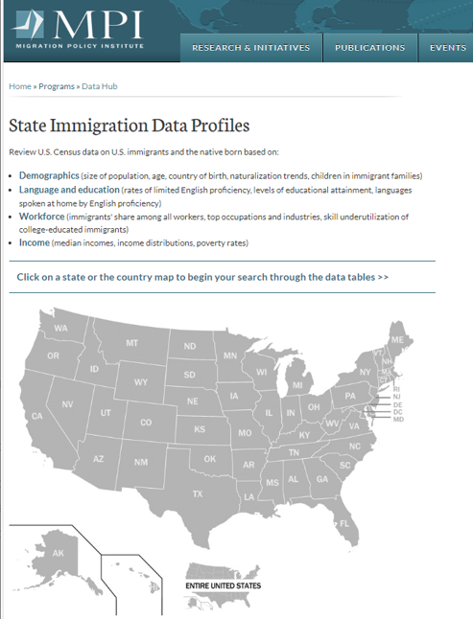
State Immigration Data Profiles
Demographics (size of population, age, country of birth, naturalization trends, children in immigrant families)
Language and education (rates of limited English proficiency, levels of educational attainment, languages spoken at home by English proficiency)
Workforce (immigrants' share among all workers, top occupations and industries, skill underutilization of college-educated immigrants)
Income (median incomes, income distributions, poverty rates)
www.migrationpolicy.org/programs/data-hub/state-immigration-data-profiles
Notes:
The Migration Policy Institute is a great place to start. Founded in 2001, the Migration Policy Institute (MPI) has established itself as a leading nonpartisan, evidence-informed institution in the field of migration policy and as a source of authoritative research, learning opportunities, and new policy ideas.
MPI has created the State Immigration Data Profiles tool using the U.S. Census Bureau’s American Community Survey (ACS) and Decennial Census data. The image on this slide is a screenshot of the interactive map. You can hover over each state and click on the link to a table with demographics, Language and education, workforces and Income date. We will take a tour of this tool later.
Sources:
Language Use in the United States: 2019 (census.gov) https://www.census.gov/content/dam/Census/library/publications/2022/acs/acs-50.pdf
People That Speak English Less Than "Very Well" in the United States (census.gov) https://www.census.gov/library/visualizations/interactive/people-that-speak-english-less-than-very-well.html
B16001 search by state 2020 acs 5 year estimates is a good choice….some data is suppressed if you enter your state and you don’t get the table, it may be that the data has been suppressed
Program: State Immigration Data Profiles | migrationpolicy.org https://www.migrationpolicy.org/programs/data-hub/state-immigration-data-profiles

Slide 12
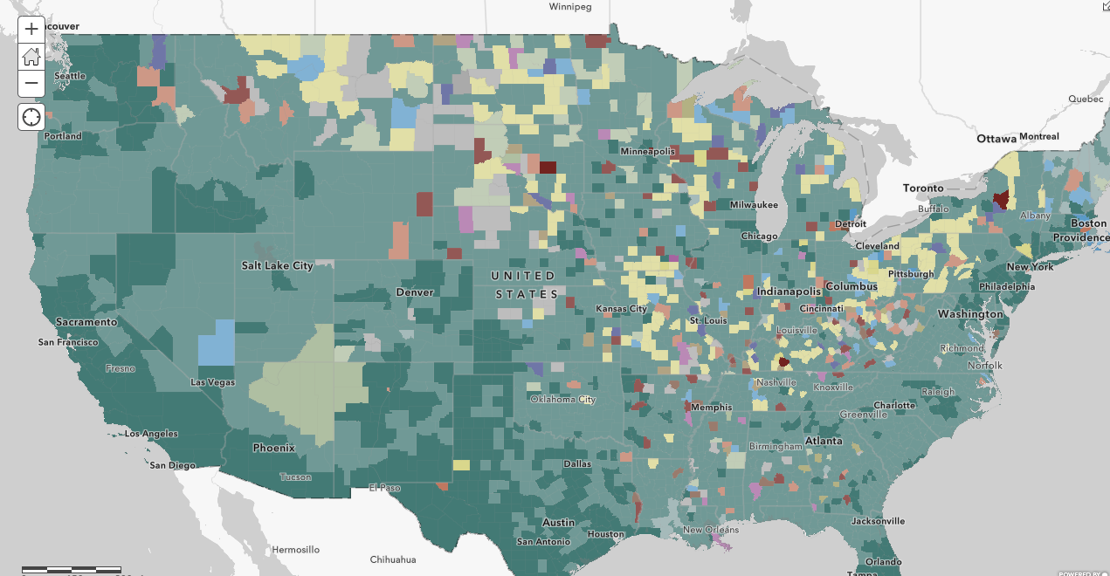
ArcGIS: What languages are spoken by people who have limited English ability?
12 different languages.
Data points:
State
County Effect
County
Tract
Notes:
Sometimes it is necessary to drill it down to the county level And ArcGIS has the perfect tool. This interactive map shows the predominant language(s) spoken by people who have limited English speaking ability
This is shown using American Community Survey data from the US Census Bureau by state, county, and tract. This map contains layers using the most current release of the U.S. Census Bureau's American Community Survey (ACS) 5-year estimates. The layers are updated annually to reflect the most current data values and geographical boundaries. This image was created in April of 2023 and updated in May of 2023.
The American Community Survey (ACS) is an ongoing survey that provides vital information on a yearly basis about our nation and its people. Information from the survey generates data that help determine how more than $675 billion in federal and state funds are distributed each year.
This map uses a feature effect to identify the counties with either 10,000 or 5% of the population having limited English ability. We will take a tour of this tool too.

Slide 13
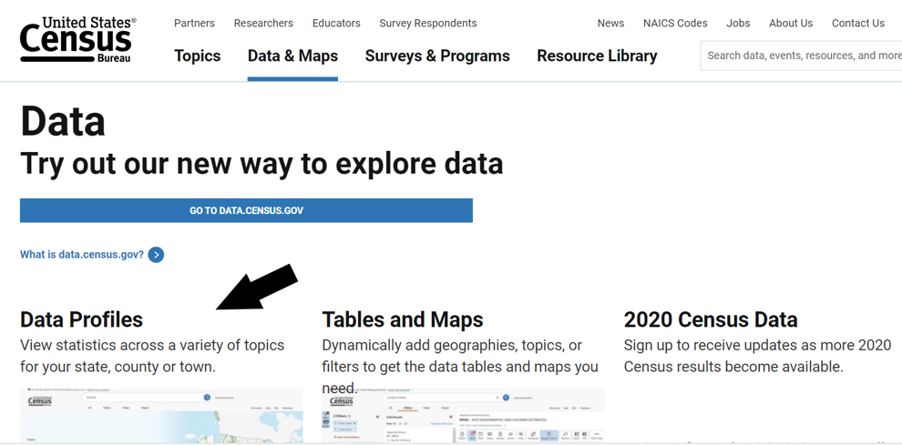
Locating Census Data
Notes:
I am including this slide for later reference. On this slide, I have a screenshot of the United States Census Data page with an arrow pointing to data profiles. This is a helpful tool for getting an overview of your local area and is included in the class handout.
Census.gov/data.html
Let’s look at the two data tools I mentioned:
Program: State Immigration Data Profiles | migrationpolicy.org
ArcGIS https://www.arcgis.com/home/webmap/viewer.html?webmap=2c15f2d8d81343d883e70a73317a5cb9

Slide 14
Information Resources
Notes:
One of the ways we support our communities is through information access. I mentioned we will quickly review some data tools, and then I will share a few free resources that are good sources of information in languages other than English, as well as information that can help us learn about the countries, health conditions, and experiences of refugees and asylees.

Slide 15
Health Information in Languages other than English
Notes:
First, we will look at the MPI state immigration profiles and the ArcGIS tool. then review five resources on the slide. In addition to these resources, I want to point out that many state health departments also have resources specific to new arrivals such as refugees and asylees, as well as information in multiple languages, so that is another place to start when searching for information.
Information sources
Migration Policy Institute: https://www.migrationpolicy.org/programs/data-hub/state-immigration-data-profiles
ArcGIS: https://www.arcgis.com/home/webmap/viewer.html?webmap=2c15f2d8d81343d883e70a73317a5cb9
MedlinePlus: https://medlineplus.gov/
Office of Minority Health: https://www.minorityhealth.hhs.gov/
CDC Refugee Health Profiles: https://www.cdc.gov/immigrantrefugeehealth/profiles/index.html
EthnoMed: https://ethnomed.org/
Health Translations: https://www.healthtranslations.vic.gov.au/

Slide 16
Thank you!
Sarah Levin-Lederer, MPH
Education and Outreach Coordinator, Region 7
Notes:
Thank you so much for your time and attention today. Please reach out with any questions or to your regional office to learn more about what NNLM offers. I believe that Rebecca will share the Evaluation Link at this time. I am happy to answer any questions you might have.

